Slide 1
Hunter Education Program Management System
Notes:
Note books and pens, use them to write down questions.
Schedule, complete paperwork, sign up for events, and all communications on this paperless system.

Slide 2
Log In
Division of Wildlife Website
Hunting
Hunter Education
Notes:
March 15 is the go live date. Any classes to schedule in the month of March still go through Rhonda. Classes after March must be done on this system.

Slide 3
Log IN
Need Email and Password you used to set up and sign up for the spring training.
Notes:
This is the log in you created.

Slide 4
Managing a Class

Slide 5
Managing a Class Schedule a Class
Click create a class to get started filling out the basic form.
Notes:
Click on create a class, a basic form will pop up to enter the information.
Switch to live and show how to enter the information to create a class.

Slide 6
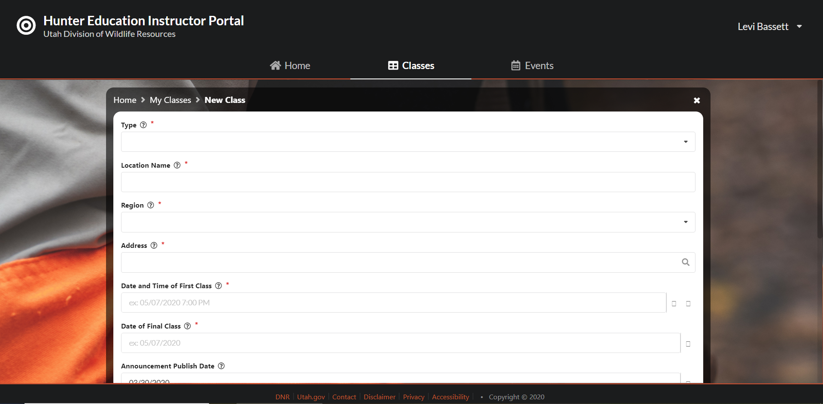
Managing a Class Schedule a Class
Fill out the information as fully and best you can.
The primary instructor is responsible for creating the class.
Location must be a google pin.
You MUST get pre-approval from SL administration to schedule a class with no minimum number of students.
Adding your contact information is optional.
Notes:
Click on create a class, a basic form will pop up to enter the information.
Switch to live and show how to enter the information to create a class.

Slide 7
Managing a Class Finding your Class
You can find the class you just created by clicking on the classes tab.
Notes:
Click on create a class, a basic form will pop up to enter the information.
Switch to live and show how to enter the information to create a class.

Slide 8
Managing a Class Adding Instructors
As the primary instructor you will need to add all assisting instructors.
All conservation officers will have an instructor number and will give it to you to add them as well.
All instructors will be required to add their hours as well as verify their hours.
Notes:
Must have all instructors numbers in order to add any instructor.
Primary has control to change any instructors roles.
Assisting can enter hours or scores for everyone but cannot finalize or make themselves primary.
Switch to live and show how to add an instructor.

Slide 9
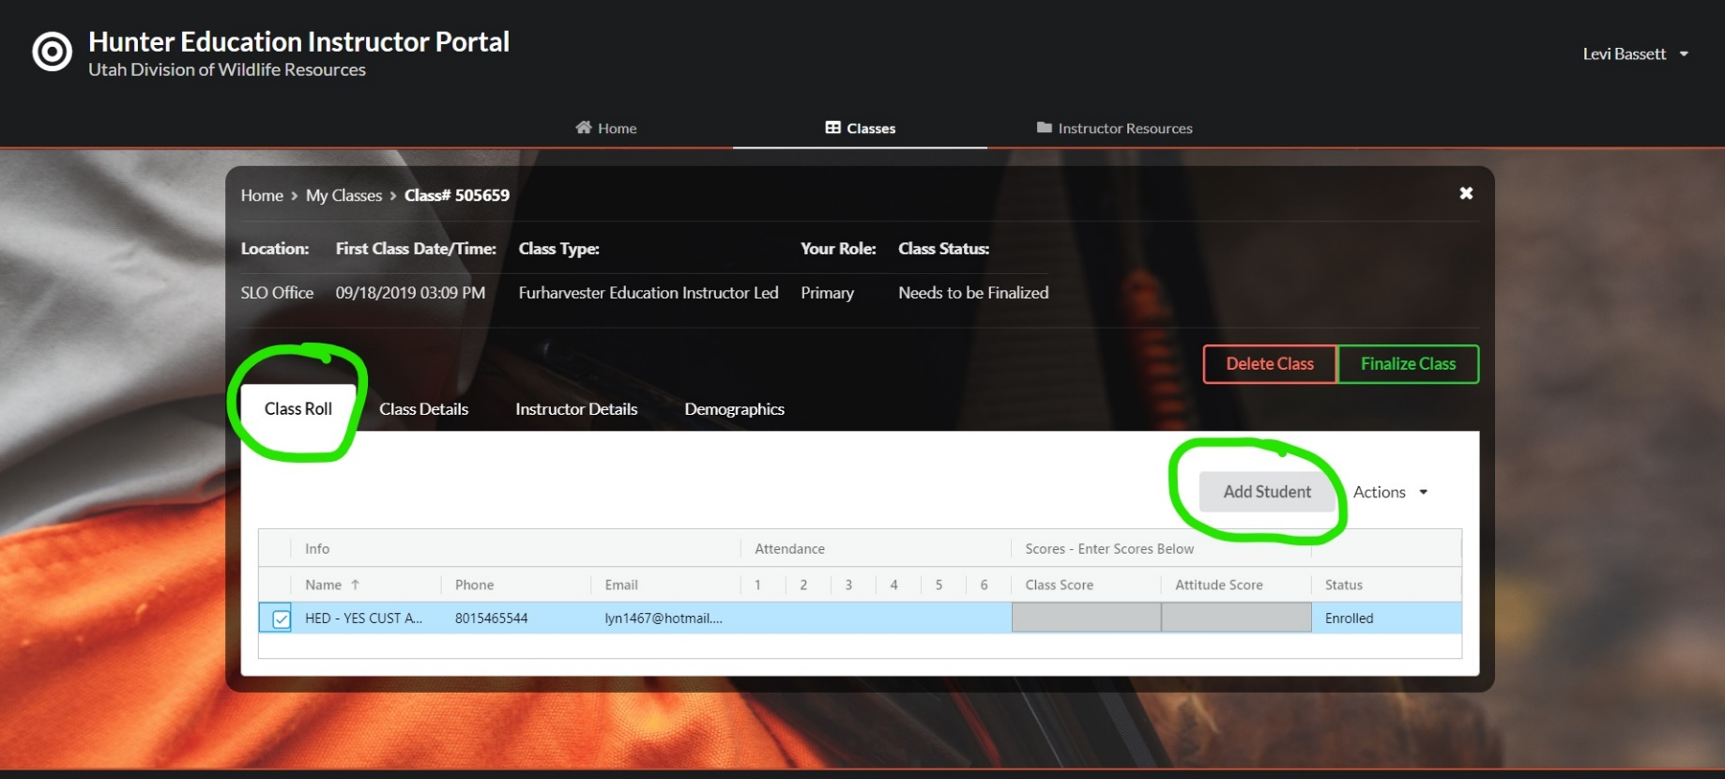
Managing a Class Adding Students Manually
You can add a student manually if for example another student brought their friend to class.
Click add student.
You will need their registration certificate number and customer ID number.
Notes:
Switch to live and show how to add students manually.

Slide 10
Managing a Class Removing Students
To remove a student click the class roll tab, select the student, then select the actions tab and remove students.
Removing a student is like handing back their certificate. This allows them to sign up for another class.

Slide 11
Managing a Class Contacting your students
To contact a student or all of your students click the class roll tab, select the student/s, then select the actions tab and email students.
This will give you a list of emails that you can copy into your own email browser and send them a message.

Slide 12
Managing a Class Enter Attendance
To enter attendance click the class roll tab, select the student/s, then double click the attendance day until a check mark appears.

Slide 13
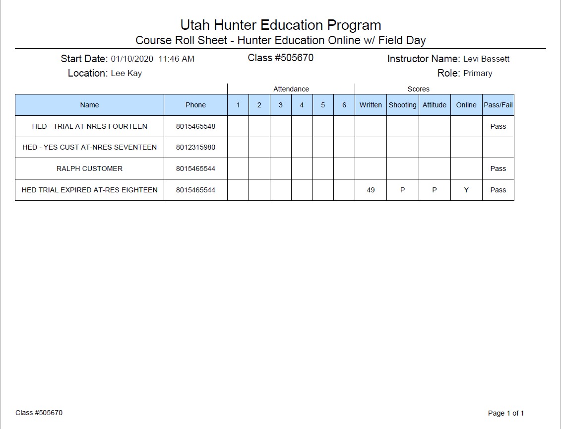
Managing a Class Printing the Roll Sheet
OPTIONAL but if you don’t have internet access this could help you keep attendance.
Under the class roll tab, click the print icon button to print the roll sheet.
This is for your records only.

Slide 14
SAVE!!! MAKE sure to hit the save button after adding any information on your students
SAVE
Save
SAVE
Save
Save
SAVE
Save
SAVE
Save
Save
SAVE
SAVE
SAVE
Save
SAVE
SAVE
Save
Save

Slide 15
Wrap up a Class

Slide 16
Wrap up a Class Enter Scores
To enter scores click the class roll tab, and double click the student score box you want to input.
Written exam must be a 1-50, shooting is a P or F, and attitude is a P or F.
There will be a place for you to track if they have brought you their online completion certificate as well.

Slide 17
SAVE!!! Again, make sure to save after entering any information on your students
SAVE
Save
SAVE
Save
Save
SAVE
Save
SAVE
Save
Save
SAVE
SAVE
SAVE
Save
SAVE
SAVE
Save
Save

Slide 18
Wrap up a Class Enter Pass or Fail
To enter scores click the class roll tab, and highlight the student you want to pass or fail, click the actions tab and select pass or fail.
You can also select the “select all” box at the top of the list of students.
This action will automatically change the students status in the DWR database and will cue the system to print them a blue card.

Slide 19
Made a mistake?
Threw a spanner in the works?
Maladjusted?
Dropped a Clanger?
Contact Rhonda, RaLynne, Levi or Gary immediately!!
Crashed and Burned?
Oops?
Mis-calculated?
Jacked it up?

Slide 20
Wrap up a Class Entering Instructors Times
Each instructor will be responsible to entering and confirming their hours.
Click the instructor details tab, select add or edit hours you can then add a work day.
Each instructor will need to verify their work days.
Notes:
Switch to live and show them how to enter instructor times.

Slide 21
Wrap up a Class Demographics
Enter demographics by selecting the demographics tab.
Use your best judgement.

Slide 22
Finalizing a Class
To finalize a class you will need to make sure all of your information is inputted and correct. This cannot be undone.
Once your information is inputted and correct go back to the class roll tab, then click on finalize class up at the top.
If you make a mistake contact the SL office immediately.
The primary instructor is responsible to finalize the class.
Notes:
Closed to all editing
Class will be sent to payment or dedicated hunter hours

Slide 23
Made a mistake?
Threw a spanner in the works?
Maladjusted?
Dropped a Clanger?
Contact Rhonda, RaLynne, Levi or Gary immediately!!
Crashed and Burned?
Oops?
Mis-calculated?
Jacked it up?

Slide 24
Resources

Slide 25
Message Center
You will receive all messages from the Hunter Education team through this notification box.
If needed a generic email will be sent to you directing you to look at your notice box.

Slide 26
Resource Center
You will find all the resources under this tab.

Slide 27
Profile
Your profile is found under your name in the top right hand corner of the main page.
Here you will be able to edit your address or phone number.
You will also be able to check your certifications including what classes you are allowed to teach, last training or seminar attended and your background check.
Notes:
Update information here

Slide 28
Events
Under the Events tab you will be able to see and RSVP for all events.
We will include spring seminars, training workshops, new instructor training, shooting sports events, and so on here.

Slide 29
View History
There are multiple ways to check your history, current classes, and classes needing attention.
The Classes tab will show all classes you have been associated with.
The side tabs will show classes in progress, upcoming classes, and classes needing attention that you are associated with.

Slide 30
Student View of Hunter Education Website

Slide 31
Student View What they See
This is the page your students will see when they want to select a class.
The class location pins show where the classes will be held. This is why it is important you use a google address when you create your class.
They will also have a list view on the side that they can see the details of the class.

Slide 32
Student View What they See
Selecting a class will give the students more details about the class.
This is where they will also register for your specific class.
There is a share button ( ˂ ) that you can use to send students to your specific class.

Slide 33
Student View What they Need
When your students click the register button they will be prompted to enter their information.
They will need to have their registration certificate number, customer ID number, an email address and a phone number in order to sign up for your class.
They will only be able to sign up for one class at a time.
Notes:
Facility and Range fees cannot be called “Registration”. The only registration is through the division website. Do not call range fees and facility fees registration.

Slide 34
Student View Trying to Dual Register
Registering for more than one class or entering false information will trigger a warning and will not allow them to proceed.
Notes:
NO NEED FOR A WAITING LIST!!!

Slide 35
Questions?
If you have questions do not hesitate to reach out.
Rhonda Jensen- 385-214-7814
RaLynne Takeda- 801-556-0655
Levi Bassett- 385-260-5850
Gary Cook- 801-580-0572

